Slide 1


30
GREATEST
LEAD GENERATION
INSIGHTS & IDEAS
THE

Slide 2

TABLE OF CONTENTS
INTRODUCTION // 3
MECHANICS OF LEAD GENERATION // 4
THE 30 GREATEST INSIGHTS AND IDEAS // 5
CHAPTER 1: CONTENT AND OFFERS // 5
CHAPTER 2: CALLS-TO-ACTION // 14
CHAPTER 3: LANDING PAGES // 22
CHAPTER 4: FORMS // 31
CHAPTER 5: CHANNELS // 37
CONCLUSION // 45

Slide 3
“LEADS ARE THE METRIC THAT, AS MARKETERS, WE RELY ON. BECAUSE LEADS MEAN MONEY.”
- KIPP BODNAR, HubSpot
Generating leads - both high in quantity and quality - is a marketers most important objective. A successful lead generation engine is what keeps the funnel full of sales prospects while you sleep. Surprisingly, only 1 in 10 marketers feel their lead generation campaigns are effective. What gives?
There can be a lot of moving parts in any lead generation campaign and often times it’s difficult to know which parts need fine-tuning. In this guide, we will expose the top 30 techniques marketers should utilize to increase leads and revenue.
So what goes into a best-of-class lead generation engine? First, lets take a look into the mechanics of high performing lead generation campaigns....

Slide 4
THE MECHANICS OF LEAD GENERATION
Before we dive into the 30 tips, we should first cover the mechanics of lead generation. The best lead generation campaigns contain most, if not all, of these components. From a tactical perspective, a marketer needs four crucial elements to make inbound lead generation happen. These include:
OFFER
CALL-TO-ACTION
LANDING PAGE
FORM
An offer is a piece of content that is perceived high in value. Offers include eBooks, whitepapers, free consultations, coupons and product demonstrations.
A call-to-action (CTA) is either text, an image or a button that links directly to a landing page so people can find and download your offer.
A landing page, unlike normal website pages, is a specialized page that contains information about one particular offer, and a form to download that offer.
You can’t capture leads without forms. Forms will collect contact information from a visitor in exchange for an offer.
The tips in this eBook will cover each of these elements so that each component is fully optimized to help you generate the most leads for your business. Now then, let’s get started.

Slide 5

CHAPTER 1
CREATING
IRRESISTIBLE
OFFERS

Slide 6
CHAPTER 1
CREATING IRRESISTIBLE OFFERS
Yes. It’s one of the most powerful words in the human language. And if you think about all the things we do as marketers, it’s ultimately to get people to say “yes” to our offers.
When an offer is exclusive, scarce, or in high demand, it becomes more desirable. Whether they are whitepapers, free trials, memberships, sales promotions or downloads, these irresistible elements can overcome a lead’s typical friction, doubt or concern.
Why do these elements work? Because they trigger a physiological reaction that makes an offer more valuable. People need to perceive the value of your offer to be greater than what you’re asking for in return. The higher the perception of value, the more irresistible the offer. So how do you create irresistible offers? Glad you asked....

Slide 7
#1
Use the Element of Scarcity
If you look at the principle of supply and demand, you’ll notice that when supply is limited, demand goes up. Scarcity has a psychological influence on us, making us want something even more if there isn’t enough to go around. Scarcity is great because it creates a fear of shortage, and thus a sense of urgency.
Limited Time Offers
Limited time offers are among the most popular in the scarcity category. Just think about your average car dealership. Practically every commercial is a limited time deal. “Get 0% financing before it’s gone!”
Limited Quantity Offers
When something is of limited quantity, it suddenly becomes more unique or exclusive. In some studies, limited quantity or supply offers have outperformed limited-time offers. Why? Because it’s hard to tell when an offer of limited quantity will suddenly become unavailable, while a time-based offer has a known end time. Limited quantity offers are great for not only getting people to say “yes” to your offer, but to avoid procrastination completely.
Limited Time and Limited Quantity
Groupon is the perfect example of using both tactics. All Groupon deals end within a certain time frame, and they limit the number of people who can buy a Groupon. That’s a powerful combination. The site also packages these scarcity tactics with discounting, which is another great value-add, especially for ecommerce businesses.

Slide 8
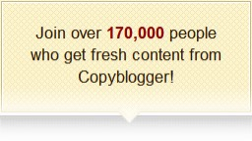
#2
The Bandwagon Effect
It’s a natural tendency for humans to copy one another, even without realizing it -- we like to be a part of tribes and social communities. So when we notice our social circle is doing one thing, we tend to follow suit. One great way to make an offer more valuable is to show that other people are participating in that offer.
Proof in Numbers
When possible, a great way to indicate how awesome an offer is to mention the number of people who have purchased, downloaded, signed up or donated.
Some examples include:
Just make sure your claims are not only true, but believable.
Webinars: On this example page promoting a webinar with Facebook, more than 40,000 have signed up.
Blog Subscription: Similarly, on a blog under the “subscribe” module, it indicates over 130,000 people have subscribed. This is proof that it’s a highly trustworthy and popular blog people should follow.
Conferences: Events like SXSW and INBOUND are some of the hottest events because tons of people flock to them every year.

Slide 9
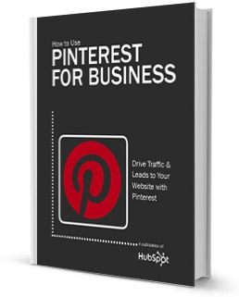
#3
Leverage Newsjacking
After Prince William and Kate Middleton got married in April of 2011, no one could stop talking about Kate’s wedding dress. Within hours after the wedding, vendors began making near-identical copies or similar styles of the Stella McCartney-designed dress. Even vendors such as David’s Bridal now have a “Royal” category so you can dress “just like Kate.”
When something is buzz-worthy, it creates high demand. In situations like this,
you can align offers with “what’s hot.” Companies will often leverage newsjacking
for this type of technique and it works very well for offers, too.
As an example, back in 2013 people couldn’t stop talking about Pinterest.
HubSpot capitalized on this craze by creating the first Pinterest eBook for
business owners and marketers, How To Use Pinterest for Business. It quickly
became one of HubSpot’s most successful eBooks with more than 125,000
downloads to date. Because it was the first and only eBook available on
Pinterest (and they made sure people knew that), and learning how to use
Pinterest for marketing was in high demand, it made the offer more unique
and thus more irresistible -- that’s the power of leveraging both timing and
popularity!

Slide 10
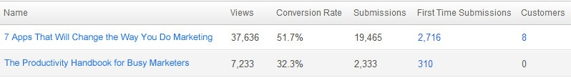
#4
Focus on Creating An Amazing Title
Brian Halligan, HubSpot CEO and co-founder, once said that “you can have a great offer with a bad title and no one will download it. But if you have an amazing title, suddenly everyone wants it.” Yes - people do judge a book by it’s cover. If your offer is a piece of content, such as a whitepaper eBook, or presentation, put effort into creating an amazing title.
For an experiment, HubSpot changed the title of an eBook and ran an A/B test to see which one would perform better. They took the original title “The Productivity Handbook for Busy Marketers” and changed it to “7 Apps That Will Change the Way You Do Marketing.”
As you can see, the revised version outperformed the original by 776% at generating leads (first time submissions). Not only that, but it resulted in more customers as well. If you’re struggling to come up with the perfect headline, try using the Headline Analyzer Tool by Advanced Marketing Institute or read
7 Proven Headlines that Convert.

Slide 11

#5
Create Offers For Different Buying Stages
The most common offer I see on most websites is “Contact Us.” Sure, you want all your prospects to talk to sales, but not everyone is ready. As you know, buyers are more likely to do their own research before even engaging with a sales rep. And, every prospect is at a different stage of exploration. Some may need more education than others. That’s why it’s important to develop different offers at different buying cycles.
Someone at the top of the buying cycle may be more interested in an informational piece like a guide or eBook, whereas someone more committed at the bottom of the cycle might be more interested in a free trial or demo. You don’t need to pick and choose; create offers for each phase, and include a primary and secondary CTA to these offers on various pages throughout your site.

Slide 12
#6
Avoid Corporate Gobbledygook
A professional image is necessary but you still want to avoid the dreaded corporate gobbledygook. What is gobbledygook you ask? Great question.
These are jargon terms and phrases that have been over-used and abused rendering them meaningless (you’ll find them mostly in the high-tech industry, but everyone is an offender at one point or another). These words are meant to add more emphasis of a particular subject but instead they make your eyes roll.
Avoid these words when describing your offers:
Next Generation
Flexible
Robust
Scalable
Easy to use
Cutting edge
Ground breaking
Best of breed
Mission critical

Slide 13
#7
Use High-Value Offer Formats
Not all offers are created equal. Some “formats” of offers perform better than others at converting leads. For example, what’s more valuable, a whitepaper or an eBook?
Below are the type of offers, in order of performance, that generate the most amount of leads.
It’s important to test different types of offers with your audience to determine what works for you. While eBooks score high on our list, you may find that reports, videos or other formats do better.
Ebooks or Guides
Templates or Presentations
Research & Reports
Whitepapers
Kits (multiple offers packaged together)
Live Webinars
On-Demand Videos
Blog (including offers in the nav or sidebar)
Blog posts (if there is a CTA in the post)
Middle-of-the-funnel offers: Demo Requests, Contact Sales, RFP, Etc. (more sales-ready offers)

Slide 14

CHAPTER 2
CALLS-TO-ACTION
THAT ROCK

Slide 15
CHAPTER 2
CALLS-TO-ACTION THAT ROCK
Calls-to-action (CTA) are the secret sauce to driving people to your offers. If your CTAs aren’t effective at capturing people’s attention and persuading them to the click, then it makes the offer useless.
CTAs can be used on product pages (non-landing pages), in display ads, email, social media, direct mail and pretty much anywhere you can market your offer.
But not all CTAs are created equal. In a world where every brand is fighting for consumers attention, it’s critical that prospects choose your offer over your competitors. In this guide, we’ll uncover tips to creating CTAs that rock.

Slide 16
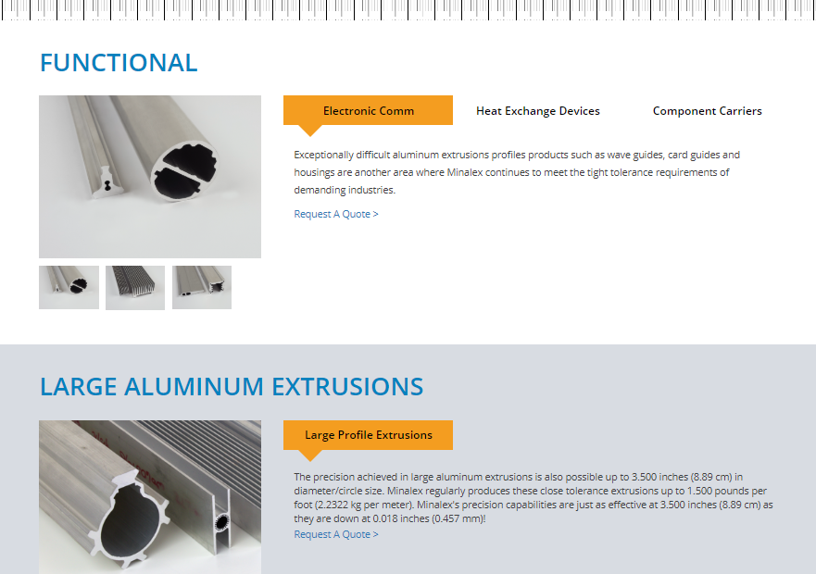
#8
Place Your CTA Where the Eye Can See
Calls-to-action do best “above the fold” - the space where your web page is viewable to the user without having to scroll down. According to heat map analysis, anything “below the fold” will only be viewed by 50% of people who visit your page. Doubling impressions on your CTAs can significantly increase your lead count.
Notice the placement of the primary CTA on the FreshBooks homepage. Two buttons for “Try it Free for 30 Days” stand out above the fold

Slide 17
#9
Clarity Trumps Persuasion
That is one of my favorite phrases I learned from the folks at Marketing Experiments. Often times, marketers will put more focus on being clever than clear. Be crystal clear about what offer is in your CTA. And be specific. If you’re giving away a free guide, say “Download our FREE guide to X.” If you’re hosting a free webinar, say “Register for our FREE webinar on X.” X should clearly convey a compelling benefit of receiving the offer. This is much more effective than “Download Now” or “Get a Free Article.” These simply aren’t specific enough.
Notice that this CTA is to promote a free eBook. There is little copy in this banner ad and a button that indicates it’s clickable.

Slide 18
#10
Use Contrast to Make CTAs Stand Out
A call-to-action is meant to stand out, so if your CTA blends in too much with your site design, no one will notice it. You want as many eyeballs to land on that call-to-action as possible, so use contrasting colors to make the CTA stand out, and more importantly, use design to make it clear it is a clickable call-to-action.
While Evernote has a beautifully designed website, the primary call-to-action for their free trial is somewhat buried because the button is the same color as the green background. It would be worth testing to see that if a different color - such as blue, red, or orange - would result in more clicks.

Slide 19
#11
Link Your CTA to a Dedicated Landing Page
This tip might seem minor, but it’s incredible how often businesses miss this opportunity. Calls-to-action are meant to send visitors to a dedicated landing page where they receive a specific offer. Do not use CTAs to drive people to your homepage. Even if your CTA is about your brand or product (and perhaps not an offer like a download), still send them to a targeted landing page that is relevant to what they are looking for. If you have the opportunity to use a CTA, send them to a page that will convert them into a lead.
This CTA for a Twitter eBook drives visitors directly to a landing page for that eBook.

Slide 20
#12
Promote Offers on Product Pages
CTAs shouldn’t be one size fits all. If your company offers various products or services, you may want to consider creating a different offer for each of them. Then you can place CTAs linking to each offer on the website pages that are most relevant to that offer.
In this example, a CTA for “Request a Demo” is placed on a product page. To generate more leads, we might also have a CTA for a “Free Guide to SEO,” because it is related to the product offering.

Slide 21
#13
Thank You Pages Are Great CTA Real Estate
Even if someone completes a form on your website (thus they’ve converted as a lead), don’t stop there. Increasing engagement is also a top priority for marketers so that prospects turn into loyal fans.
Once someone reaches a “thank you page,” the page that a visitor arrives on after completing a form, use that space as an opportunity to promote more offers and content. For example, if a visitor on hubspot.com downloads a guide on email marketing, we can offer them another offer for a Email RFP for a chance to see a demo of our email marketing platform.
PrecallPro, offers a secondary call-to-action for a demonstration on their thank-you page.

Slide 22

CHAPTER 3
LANDING PAGES
THAT CONVERT

Slide 23
CHAPTER 3
LANDING PAGES THAT CONVERT
Landing pages are one of the most important elements of lead generation. In fact, according to MarketingSherpa’s research, landing pages are effective for 94% of B2B and B2C companies. The use of landing pages enables marketers to direct website visitors to targeted pages and capture leads at a much higher rate.
What’s great about landing pages is that they direct your visitors to one particular offer without the distractions of everything else on your website. Visitors are on a landing page for one and only purpose: to complete the lead capture form.

Slide 24
#14
Elements of an Effective Landing Page
Landing pages, sometimes called a “Lead Capture Page,” are used to convert visitors into leads by completing a transaction or by collecting contact information from them. Landing pages consist of:
A headline and (optional) sub-headline
20 Marketing Trends & Predictions for 2016 & Beyond
A brief description of the offer
At least one supporting image
(Optional) supporting elements such as testimonials or security badges
And most importantly, a form to
capture information

Slide 25
#15
Remove the Main Navigation
Removed main navigation
Once a visitor arrives on a landing page, it’s your job to keep them there. If there are links on the page to move about your website, it will distract the visitor and decrease the chance of them converting on the page.
One of the best ways to increase your landing page conversion rates is to simply remove the main navigation from the page. That’s it!

Slide 26
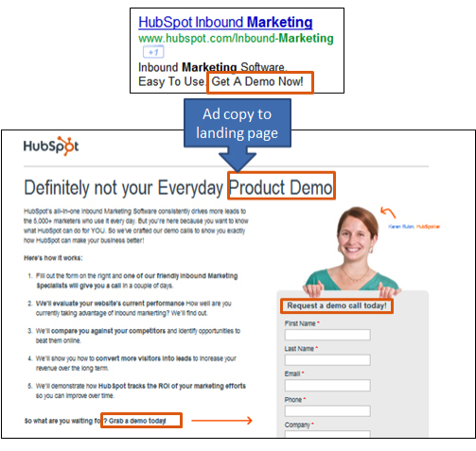
#16
Match the Headline of the Landing Page to the Corresponding CTA
Keep your messaging consistent on both your CTA and the headline of the landing page. If people click on a link for a free offer and then find out there’s a catch on the landing page, you’ll instantly lose their trust. Similarly, if the headline reads differently than the CTA, it might lead to confusion, and the visitor might wonder if the CTA is linked to the wrong page.

Slide 27
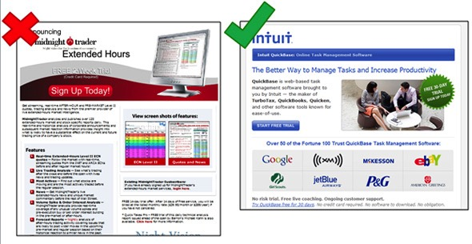
#17
Less is More
I’m sure you’re aware of the rule “keep it simple, stupid.” The same applies to landing pages. A cluttered page means a distracted visitor. Be brief and to the point; it’s in the offer itself where you give more information. In addition to your headline, include a brief paragraph explaining what the offer is, followed by a few bullet points outlining the benefits of the offer.

Slide 28
#18
Emphasize the Benefits of the Offer
Make it clear in your brief paragraph and/or bullet points what the benefits of the offer are. It’s more than just listing what the offer is comprised of; it takes a bit of spin. Instead of “Includes specifications of product XYZ,” say something like “Find out how XYZ can increase productivity by 50%.” In other words, convey the value of your offer clearly and effectively.
The landing page copy tells the visitor what they will receive when downloading the offer.

Slide 29
#19
Encourage Social Sharing
On your landing page, don’t forget to include buttons to enable your prospects to share content and offers. Include multiple social media channels as well as email, since people have different sharing preferences. When your offer is shared more, more people land on the page, and therefore more people fill out your form and become leads!
Social media sharing buttons are prominently displayed on the page.

Slide 30
#20
More Landing Pages Equal More Leads
According to a marketing benchmarks report, companies see a 55% increase in leads by increasing landing pages from 10 to 15. The more content, offers and landing pages you create, more opportunities to generate more leads for your business.

Slide 31

CHAPTER 4
OPTIMIZED
FORMS

Slide 32
CHAPTER 4
OPTIMIZED FORMS
Forms are the key to a landing page. Without them, there is no way to “convert” a visitor into a lead. Forms come in handy when it’s time for people to sign-up, subscribe to your site or download an offer.
The following tips will uncover how to build great landing page forms.

Slide 33
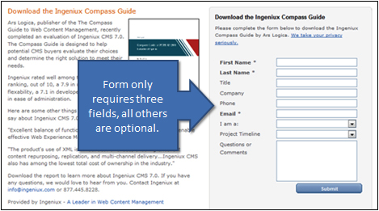
#21
The Right Form Length
You might be wondering how much or how little information you should require with a form. There is no magic answer when it comes to how many fields your form should contain but the best balance would be to collect only the information you really need.
The fewer fields you have in a form,
the more likely you will receive more
conversions. This is because with each
new field you add to a form, it creates
friction (more work for the visitor) and
fewer conversions. A longer form looks
like more work and sometimes it will be
avoided all together. But on the other
hand, the more fields you require, the
better quality those leads might be.
The best way to determine what works
best is to test it.

Slide 34
#22
To Submit or Not to Submit
That is the question most of your visitors are asking. One of the best ways to increase form conversion rates is to simply NOT use default word on your button: “SUBMIT.”
If you think about it, no one wants to “submit” to anything. Instead, turn the statement into a benefit that relates to what they are getting in return.
For example, if the form is to download a brochure kit, the submit button should say, “Get Your Brochure Kit.” Other examples include “Download whitepaper,” “Get your free ebook,” or “Join our Newsletter.”
Another helpful tip, make the button big, bold and colorful. Make sure it looks like a button (usually beveled and appears “clickable”).
Don’t do this!

Slide 35
#23
Reduce Anxiety With Proof-Elements
People are more resistant to give up their information these days, especially because of the increase in spam. There are a few different elements you can add to the form or landing page to help reduce a visitor’s anxiety to complete the form:
Add a privacy message (or link to your privacy policy) that indicates their email will not be shared or sold.
If your form requires sensitive information, include security seals, a BBB rating or certifications so that visitors know their information is safe and secure.
Adding testimonials or customer logos is another great to indicate social proof. For example, if your offer was for a Free Trial, you may want to include a few customer testimonials about your product or service.
Example of security seals at the bottom of a landing page form.

Slide 36
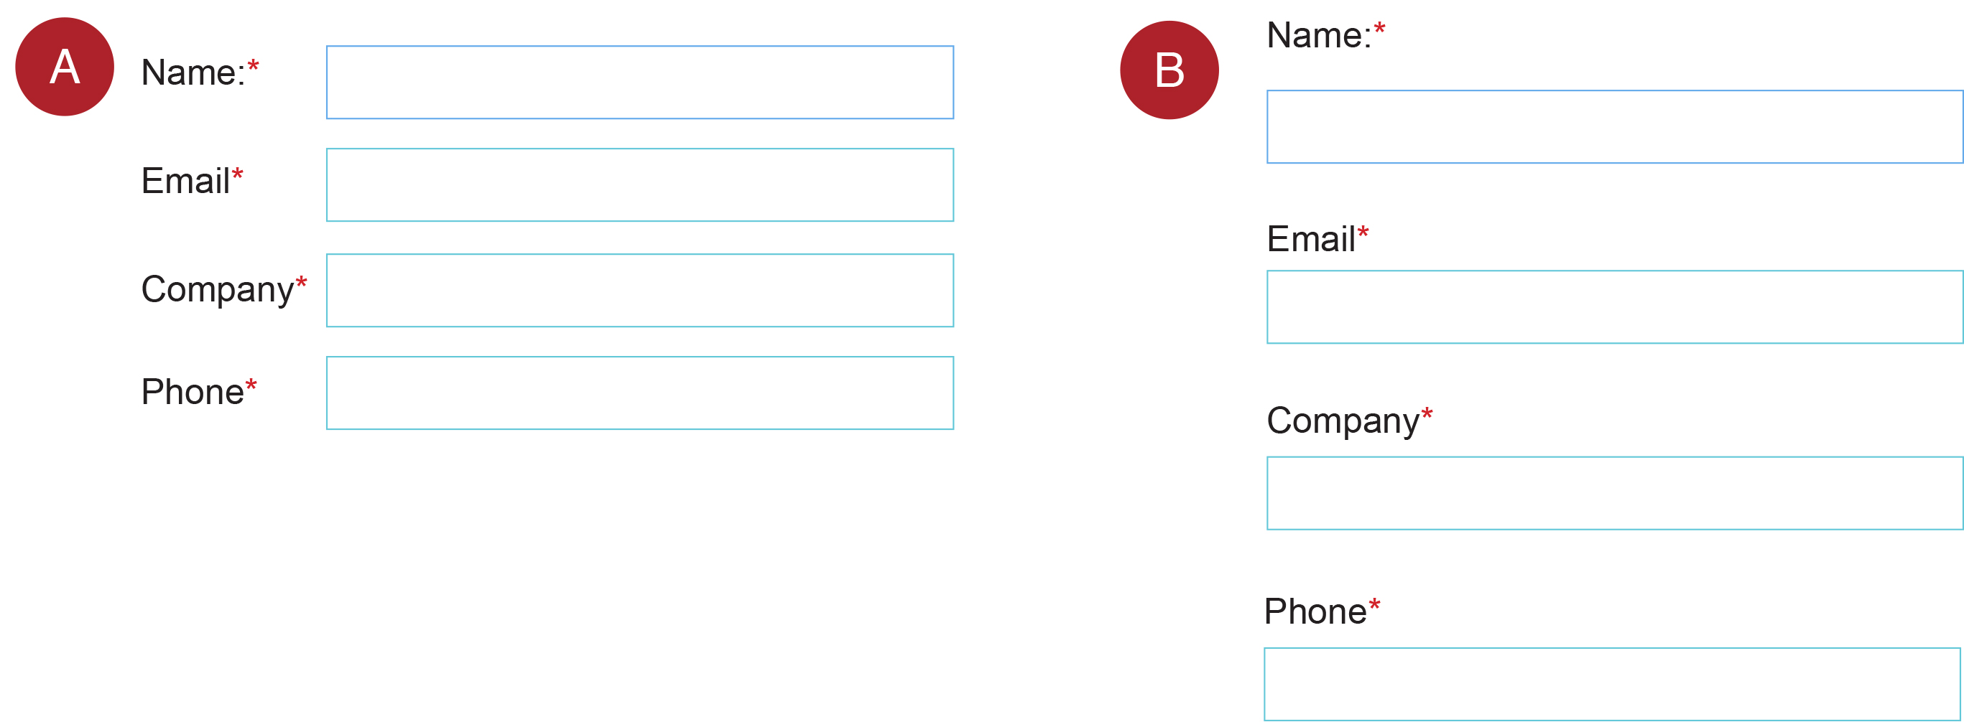
#24
Make the Form Appear Shorter
Sometimes people won’t fill out a form just because it “looks” long and time-consuming. If your form requires a lot of fields, try making the form look shorter by adjusting the styling.
For example, reduce the spacing in between fields or align the titles to the left of each field instead of above it so that the form appears shorter. If the form covers less space on the page, it may seem as if you’re asking for less.
Both forms have the same amount of fields, but version A might look shorter than B on the page.

Slide 37

CHAPTER 5
MULTI-CHANNEL
LEAD
GENERATION

Slide 38
CHAPTER 5
MULTI-CHANNEL LEAD GENERATION
Your website isn’t a silo. Marketers must utilize many other channels in order to maximize their lead generation efforts. In this sense, a channel might be a retail store, a website, a social media platform, an email or a text message. The objective is to make it easy for buyers to research, evaluate and purchase products in any way that is most appropriate for them. It’s all about having the right marketing mix.
In this last chapter, we will briefly cover a few channels that help businesses generate the most amount of leads.

Slide 39
#25
Blogging Brings in the Leads
According to HubSpot’s recent Benchmarks report, companies that blog 6-8 times per month double their lead volume. This proves that blogging is a highly effective channel for lead generation.
In every blog post, include hyperlinks to landing pages within the copy of the post, as well as a prominent call-to-action.
An example of a CTA at the bottom of a blog post. The offer matches the content of the post for relevance.

Slide 40
#26
Email Marketing
Many businesses may think that email marketing is only best used when communicating with existing prospects and customers. Not so! Email can be a great channel for new lead generation. Here are some ways you can use email to generate more new prospects:
Focus on an opt-in strategy. If you’re buying email lists and spamming your prospects, no one will want to share your email with others. They will only want to unsubscribe! The first step to email lead generation is to make sure you have happy subscribers that enjoy receiving emails from you.
Send people valuable offers. If you send really interesting or valued offers - whether it’s downloads, discounts or educational content - people will more likely share your emails with their friends or colleagues.
Give people the tools to share. Don’t forget to add a “Forward to a Friend” link or social media sharing buttons within each email so people are encouraged to pass it on.
Simple email promoting a valuable offer that includes social media sharing buttons.

Slide 41
#27
Social Media
Social media isn’t just for liking funny pictures or tweeting what you ate for breakfast. Social media is an emerging channel that many businesses are taking advantage of. Here are some great tips for generating leads on social networks.
Build a loyal following. Building a relationship with potential customers is a critical first step. Social media connections are really about people-to-people, not always company-to-individual. Get to know your audience online, communicate and share information. In order to generate leads, you need to have human interaction with others.
Remember, social media is a dialogue. Companies that only use social media to blast out messages about themselves aren’t using social channels effectively. The goal is to interact with others and be helpful. When you share content on social media, don’t always post something that relates to your company. Share links to other interesting things you’ve found online. People will be very thankful you are noticing their work, too!
Influence connections for content sharing. Publishing and sharing content that directs traffic to targeted landing pages is the single biggest lever to increase lead generation through social media. Share your new content offers by posting links to landing pages, and in addition, share blog posts, discounts and other great resources.

Slide 42
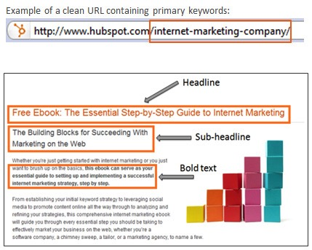
#28
Organic Search
While promoting your offers in many channels is crucial for lead generation, it’s also equally important to make it easy for people to find your landing pages through search engines. To do this, you need to apply search engine optimization (SEO) best practices to your landing pages, such as:
Pick a primary keyword for each landing page and focus on optimizing that page for that word. If you oversaturate a page with too many keywords, the page will lose its importance and authority because search engines won’t have a clear idea of what the page is about.
Place your primary keywords in your headline and
sub-headline. These areas of content have greater weight to search engines.
Include the keywords in the body content but don’t use them out of context. Make sure they are relevant with the rest of your content.
Include keywords in the file name of images (e.g. mykeyword.jpg) or use them in the ALT tag.
Include the keywords in the page URL.

Slide 43
#29
Use Links and CTAs within Offers
Your offers themselves are great channels for lead generation. For example, in this eBook I have included links to other content offers you can download. As people share this eBook, they may discover other resources that we offer by the links within the content.
Within this eBook “25 Website Must-Haves,” are links to other eBooks and guides.

Slide 44
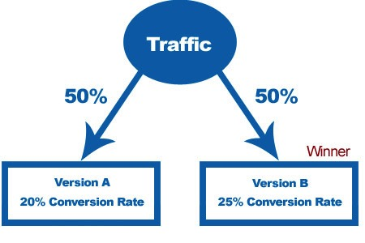
#30
A/B Testing
While this isn’t a channel per say, it is a great way to increase leads across all channels and tactics. A/B testing can be used in calls-to-action, landing pages, email marketing, advertising, and more. According to HubSpot research, A/B testing your landing pages and other assets can help you generate up to 40% more leads for your business. When done correctly, A/B testing can provide a huge competitive advantage for your company.

Slide 45
CONCLUSION
Generating leads online has the power to transform your marketing. Using great offers, calls-to-action, landing pages and forms - while promoting them in multi-channel environments - can reduce your cost-per-lead while delivering higher quality prospects to your sales team.
The basics herein are just the beginning. This guide contains many best practices for every aspects of lead generation to help bolster your conversion rates, but these tactics are only the tip of the iceberg. Continue to tweak and test each step of your inbound lead generation process in an effort to improve lead quality and increase revenue.
Now go, young grasshopper, on your way to becoming a lead generation master.

Slide 46
SIGN UP FOR A FREE
INBOUND MARKETING
ASSESSMENT
CLICK HERE TO START
908.534.9044 I info@delianet.com
www.delianet.com

Slide 47
ABOUT DELIA ASSOCIATES
Founded in 1964 and based in New Jersey, Delia Associates is a second-generation business branding and marketing firm specializing in brand development, website development, content, and search marketing. Clients range from global to regional business-to-business companies, with an emphasis on manufacturing organizations. The firm’s proprietary Brand Leadership Solution®, a unique brand-based marketing platform, has helped hundreds of brands establish market distinction, generate increased demand, and achieve sustainable growth. For more information, please visit: www.delianet.com.

