Slide 1
The Highly Successful B2B Sales Executive’s
WEEKLY CALENDAR
B2B Sales Executives have a lot on their plates, often taking on multiple roles and responsibilities (sometimes too many) for their organizations. Add to this a daily calendar bursting with meetings and overflowing inboxes, and it’s easy to see why many sales professionals feel overwhelmed, lose focus and are ultimately unproductive.
Sales and leadership training experts advocate various time-management strategies to tackle “to do” lists. Some methods focus on prioritizing long lists by urgency; other tactics are goal-oriented. Still other approaches are based on measuring productivity. I’ve tried most of them, but the time-management strategy that consistently works for me is straightforward and simple. It has two main components – pre-planning and block scheduling. Pre-planning involves creating a defined and strategic work plan for the week ahead; block scheduling divides your workday into organized blocks of time that are focused on specific priorities.
Here’s what it looks like:

Slide 2
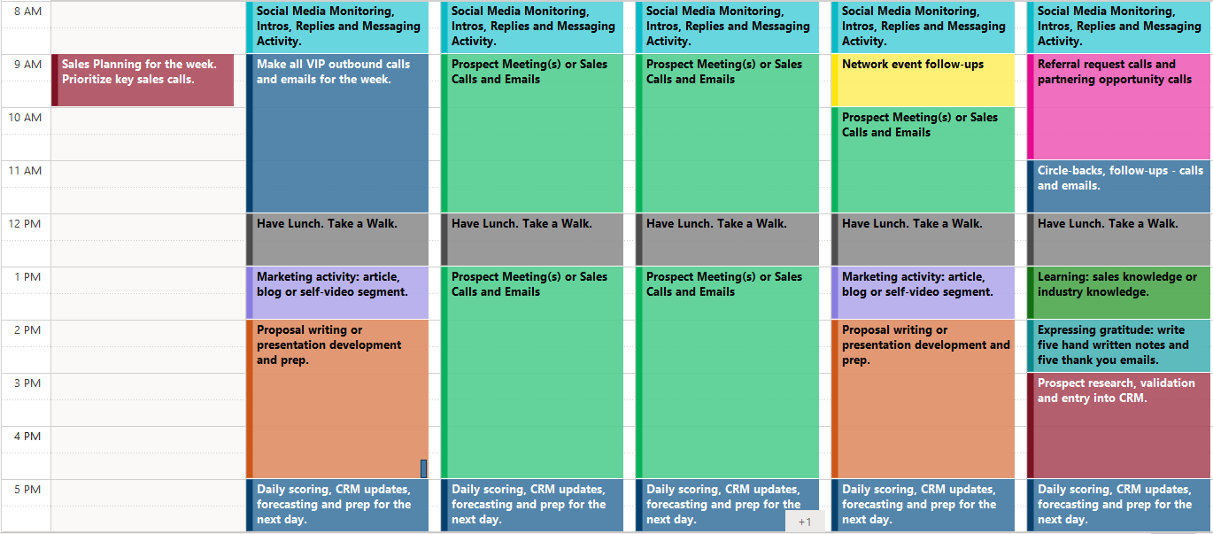
The Highly Successful B2B Sales Executive’s
WEEKLY CALENDAR
For Maximum Sales Performance and Productivity.

Slide 3
The Highly Successful B2B Sales Executive’s
WEEKLY CALENDAR
The Weekend: Highly successful sales professionals are that way because they “plan for success.” Use one hour of off-hour time to plan out the coming week, whether that’s Saturday morning or Sunday evening. It’s all about setting up each week for success.
Monday Morning: Make the most important calls of the week first. By applying discipline to this behavior, the hardest and most important calls – that also usually take the most mental and emotional energy – are attended to first. These calls also set the pace and tone for the week ahead.
One Early Morning or Late Evening: At least once per week, schedule some form of person-to-person networking, whether an event, a breakfast, a learning seminar or even a virtual function.
Peak Activity Time: That’s usually the middle of the week (Tues – Thurs). These are the blocks of time where meetings are scheduled, or outbound calling and emailing occurs.
Low Activity Time: That’s usually the bookends to the week (Monday afternoon and Friday afternoon). These are great times to block out for proposal writing, prospect research or learning.
Every Day: It’s important to block out time for lunch and a little down time. Food is fuel for the body, and everyone needs a short breather to refresh before re-engaging in the afternoon’s activities.

Slide 4
The Highly Successful B2B Sales Executive’s
WEEKLY CALENDAR
One final thought: While pre-planning and block scheduling boosts productivity, adding structure and focus to your daily calendar, remember that business is fluid. You can embrace these concepts, but you must adjust and accept change as business requires. Some situations can’t be ignored, and some opportunities simply can’t wait. The good news, though, is that you can easily return to your schedule once you have addressed any pressing issues or priorities.
About Ed Delia
Ed Delia is the second-generation leader of Delia Associates, a business branding and marketing firm founded in 1964 by his father, Michael A. Delia (who passed in 2012). Across that 55+ year span, the company has helped hundreds of b2b brands successfully grow through all circumstances and economic conditions. To date, Delia Associates has built or revitalized over 300 b2b brands. Our proven and proprietary Brand Leadership Solution® is our core platform for rapid brand development and deployment.
If you want to find out more or simply “talk brand,” contact Ed at:
908-534-9044 | edelia@delianet.com | www.delianet.com

